Slide 1
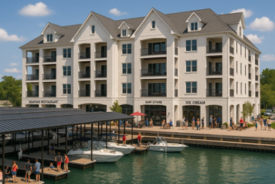


Slide 2
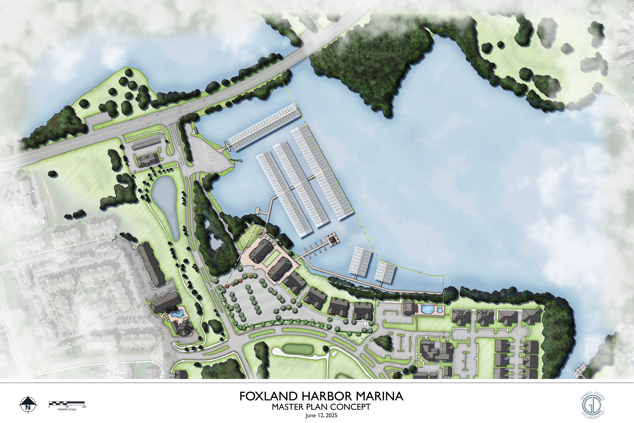

Slide 3


Marina Campus Includes
Luxury Condominiums
112 Total Residences
Most Condominiums Feature:
Covered Parking
Storage
Lake and Golf Course Views
Foxland Harbor Marina

Slide 4
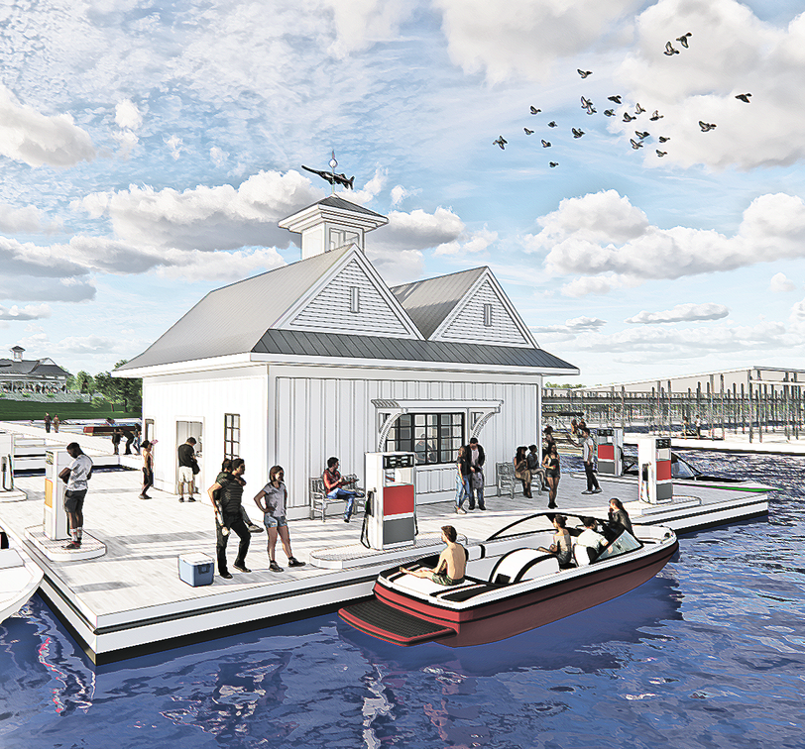
Why now
There hasn’t been a marina developed in Gallatin in almost 70 YEARS
To put that in perspective: when it was built, Gallatin had a population of 5,000
Today’s population is now over 55,000 AND GROWING
Foxland Harbor Marina

Slide 5
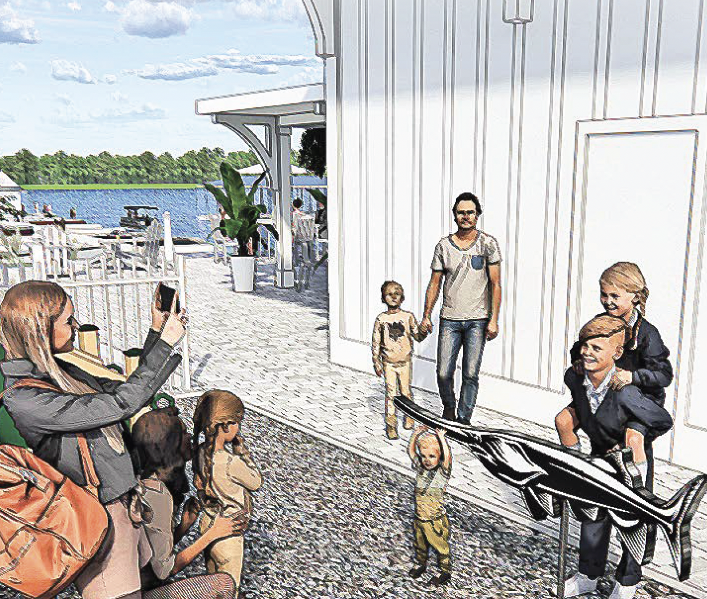
Amenities
Nature Trail
Cornhole/Outdoor Games
Pavillion
Adult Swings
Comfortable Outdoor Seating
Fuel Dock Services
Restaurant
Shops
Playground
COMMUNITY STAKEHOLDER SURVEY
Foxland Harbor Marina

Slide 6

Transit Friendly
In traditional neighborhoods, residents must drive their cars to:
Restaurants
Golf
Swim
Fitness
Boating
Shops
Coffee
COMMUNITY STAKEHOLDER SURVEY
Foxland Harbor will offer pedestrian, bike, and golf cart access . The bike and golf cart parking is located near the restaurant for convenience of the neighborhood. This creates a community with less traffic and parking demand.
Foxland Harbor Marina

Slide 7
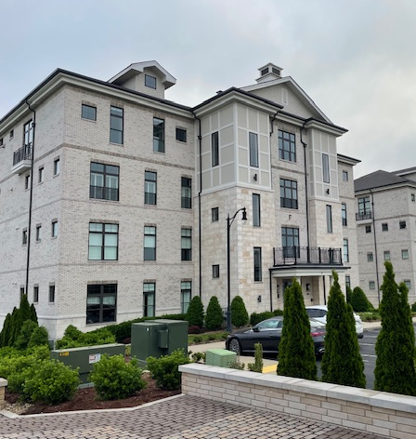
Residences
Luxurious and exceptional condominiums
COMMUNITY STAKEHOLDER SURVEY
Foxland Harbor Marina

Slide 8
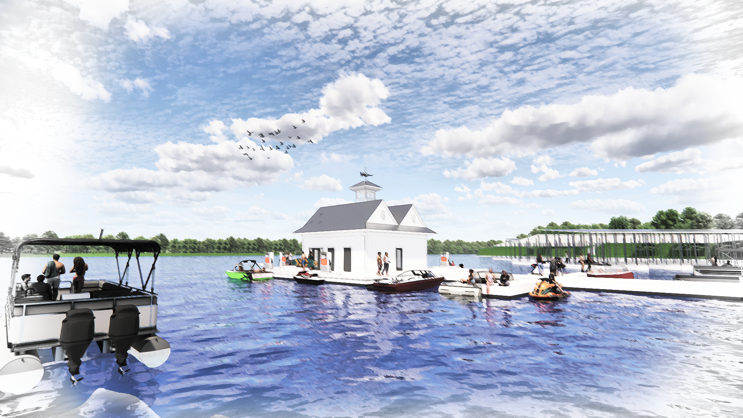
Boat Club
May Include:
Jet Skis
Paddle Boards
Kayaks
Pontoon Boats
Foxland Harbor Marina

Slide 9

Fuel Dock
Services
Dock Support
Small Dock Store
Restrooms
Air Pump
Boat Rentals
Foxland Harbor Marina

Slide 10
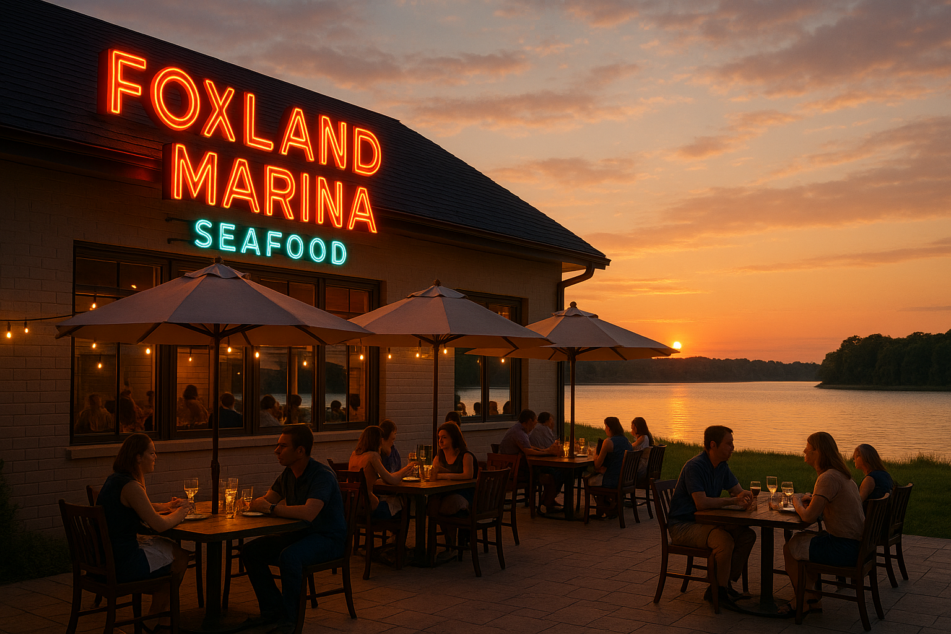
Restaurant
Enjoying a meal by the water is an experience we all share.
Community survey showed a desire for farm to table, seafood/oyster bar, and steakhouse options.
Foxland Harbor Marina

Slide 11
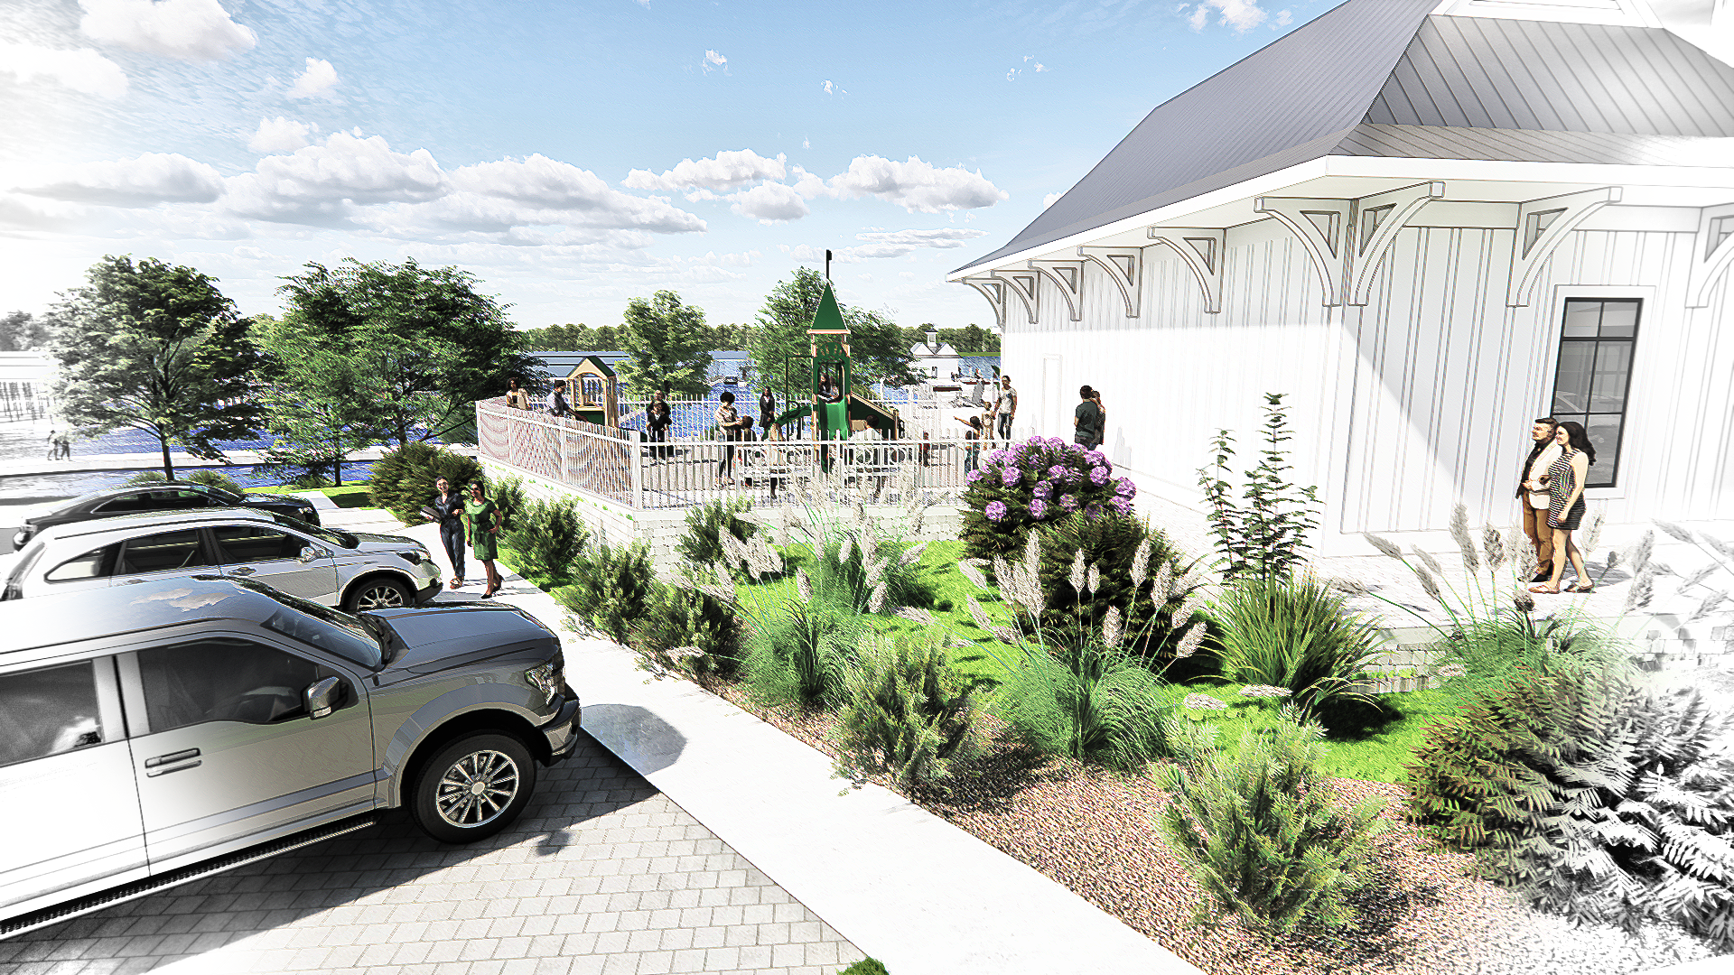
Retail Shops
Potential shops include:
Ship Store
Coffee
Ice Cream
Day Spa
Sandwich
Marina Office
COMMUNITY STAKEHOLDER SURVEY
Foxland Harbor Marina

Slide 12
Disclaimer:
The views and opinions expressed in this presentation are solely those of Foxland Harbor Marina and do not necessarily reflect those of any affiliated organizations, partners, or stakeholders. The information contained herein is based on current plans, community feedback, and design concepts as of the date of this presentation. While every effort has been made to ensure the accuracy of the information provided, Foxland Harbor Marina makes no guarantees and assumes no liability for errors, omissions, or changes that may occur. All plans and concepts are subject to revision.
CONTACT
foxlandharbormarina@gmail.com

